Slide 1
Once Upon
A Time ........
........before Linked In
and Maang..............

Slide 2
.......... there
was
Yammer

Slide 3
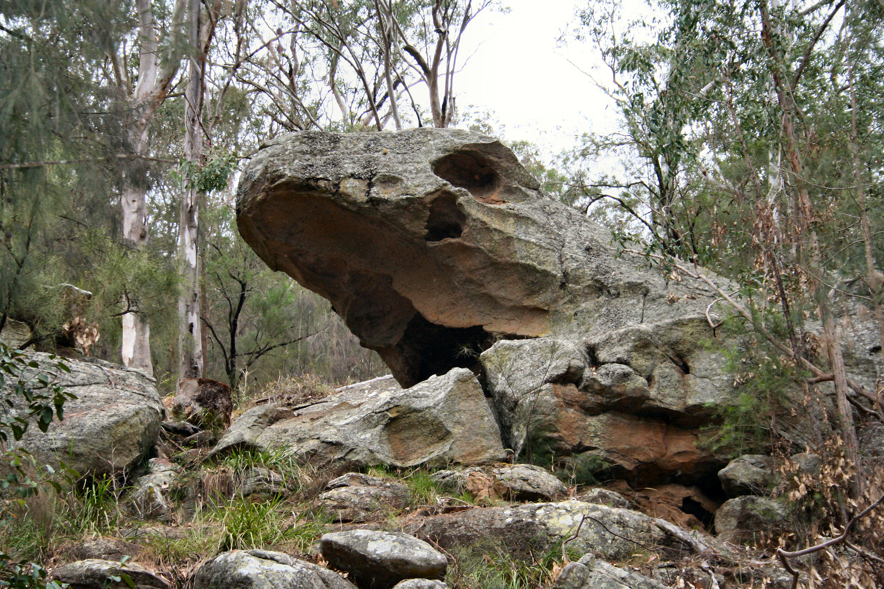
HUNTER SPORTS HIGH
8 ABORIGINAL WAYS of LEARNING
Aboriginal Pedagogies at the Cultural Interface
developed from research done by
TYSON YUNKAPORTA

Slide 4
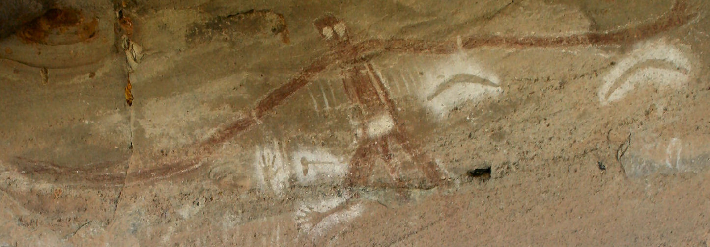
Standpoint
Processes
Cultural Interface
Practice

Slide 5
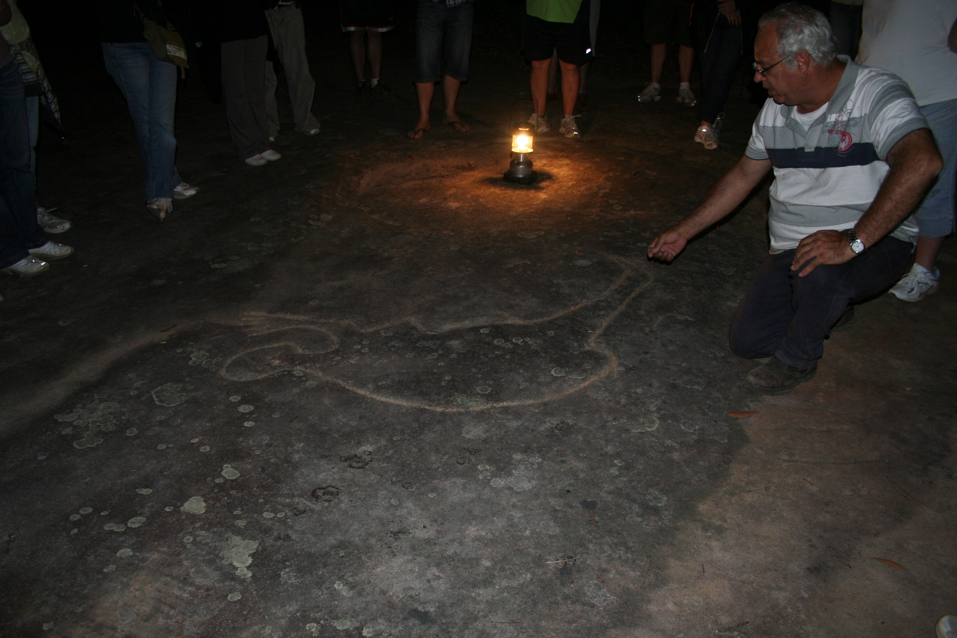
STANDPOINT
Ontology
Epistemology
Methodology
Axiology

Slide 6
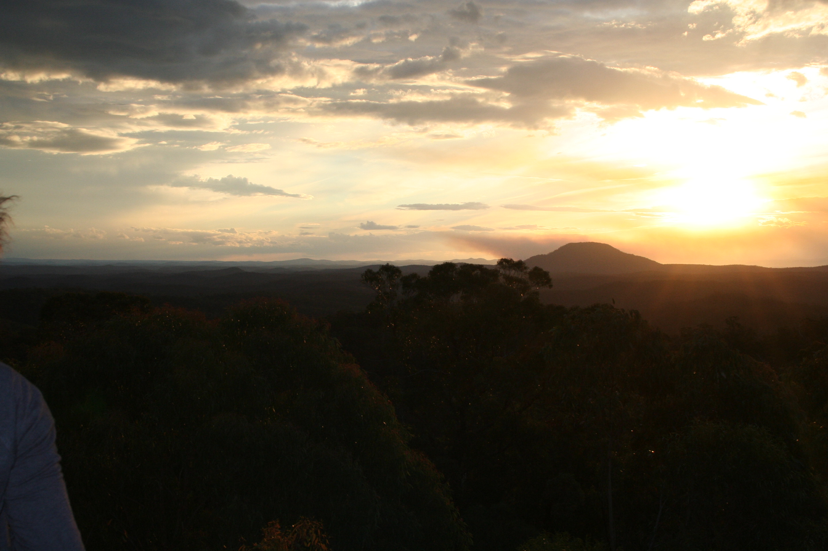
PROCESSES

Slide 9
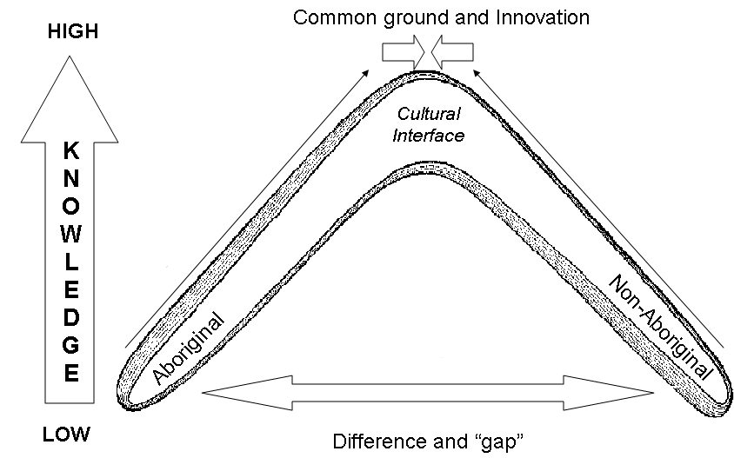
Cultural Interface Protocols for Engaging with Aboriginal Knowledge
1. | Use Aboriginal processes to engage with Aboriginal knowledge.
2. | Approach Aboriginal knowledge in gradual stages, not all at once.
3. | Be grounded in your own cultural identity (not “colour”) with integrity.
4. | Bring your highest self to the knowledge and settle your fears and issues.
5. | Share your own stories of relatedness and deepest knowledge.
6. | See the shape of the knowledge and express it with images and objects.
7. | Build your knowledge around real relationships with Aboriginal people.
8. | Use this knowledge for the benefit of the Aboriginal community.
9. | Bring your familiar understandings, but be willing to grow beyond these.
10. | Respect the aspects of spirit and place that the knowledge is grounded in.
Boomerang Matrix of Cultural Interface Knowledge

